Slide 1
Resume
It is taken the stock prices of a company for a specific time slot.
The result of the prediction is presented binary as follows:
0 – the share price will not fall under the barrier.
1 – the share price will fall under the barrier.
The model can used in different cases such as the
financial instrument Barrier reverse convertibles (BRC).
The barrier is this case is defined as a percent of the market
share price on a specific date. The data is
taken from Yahoo finance.

Slide 2

THE TASK
Based on historical data of the underlying stock/stocks, we are looking for a mechanism which can determine the probability of the underlying stock prices dropping below the barrier and thus resulting in a capital loss for the client.

Slide 3
THE SOLUTION
1. Define the parameters:
TICKER: GE
PERIOD OF HISTORICAL DATA: 1999-05-01 to 2019-05-01
SHARE ADJ.PRICE ON 2019.02.08 = 9.371596USD
BARRIER = 50% (4,685798USD )

Slide 4
OUR SOLUTION
2. Prepare the data:
CLEANING DATA
INTERPOLATE MEASING VALUES
DATA NORALIZATION( USE LOG RETURNS)
MAKE THE ADF TEST FOR STATIONARITY

Slide 5
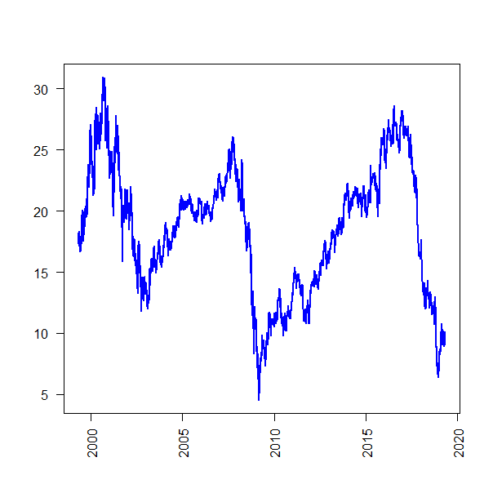
Linear interpolate
Missing values: 2272
Barrier for the share percent of price of the issuing date
barrier_share_price = share_price*barrier
dd2$target = ifelse(dd2$adj>barrier_share_price,0,1)
Data normalization - Use log returns
Augmented Dickey-Fuller Test
data: dd2$log_rets_adj Dickey-Fuller = -18.691, Lag order = 19, p-value = 0.01
alternative hypothesis: stationary

Slide 6
THE SOLUTION
3. Making additional variables:
Money Flow Index – MFI
Relative Strength Index
Moving Average Convergence Divergence – MACD

Slide 7
Money Flow Index - MFI
KEY TAKEAWAYS
The Money Flow Index (MFI) is a technical indicator that generates overbought or oversold signals using both prices and volume data.
An MFI reading above 80 is considered overbought and an MFI reading below 20 is considered oversold, although levels of 90 and 10 are also used as thresholds.
A divergence between the indicator and price is noteworthy. For example, if the indicator is rising while the price is falling or flat, the price could start rising.

Slide 8
Relative Strength Index
KEY TAKEAWAYS
In finance, the Relative Strength Index (RSI) is a type of momentum indicator that looks at the pace of recent price changes so as to determine whether a stock is ripe for a rally or a selloff.
The RSI is used by market statisticians and traders, in addition to other technical indicators as a means of identifying opportunities to enter or exit a position.
Generally, when the RSI surpasses the horizontal 30 reference level, it is a bullish sign and when it slides below the horizontal 70 reference level, it is a bearish sign.

Slide 9
Moving Average Convergence Divergence – MACD
KEY TAKEAWAYS
Moving Average Convergence Divergence (MACD) is calculated by subtracting the 26-period exponential moving average (EMA) from the 12-period EMA.
MACD triggers technical signals when it crosses above (to buy) or below (to sell) its signal line.
The speed of crossovers is also taken as a signal of a market is overbought or oversold.
MACD helps investors understand whether the bullish or bearish movement in the price is strengthening or weakening.

Slide 10
OUR SOLUTION
4. Making a model - XGBOOST :
Money Flow Index – MFI
Relative Strength Index
Moving Average Convergence Divergence – MACD
Target

Slide 11

FIT THE MODEL
watchlist=list(train=dtrain, test=dtest)
eq=xgb.train(data=dtrain, max_depth=2, eta=1, nthread = 2, nrounds=10, watchlist=watchlist, objective = "binary:logistic")
RESULTS
1] train-error:0.000391 test-error:0.000000 [2] train-error:0.000391 test-error:0.000000 [3] train-error:0.000391 test-error:0.000000 [4] train-error:0.000391 test-error:0.000000 [5] train-error:0.000391 test-error:0.000000 [6] train-error:0.000391 test-error:0.000000 [7] train-error:0.000391 test-error:0.000000 [8] train-error:0.000391 test-error:0.000000 [9] train-error:0.000391 test-error:0.000000 [10] train-error:0.000391 test-error:0.000000

Slide 12

Result
Predicted 0

